Slide 1
Large language modeling
From:
DS100 UC Berkeley

Slide 2
Large language models
It was once a dream to generate human-like sentences with correct grammar and meaning
Now LLMs model languages
generating fluent long coherent text
creative writing
complex coding assistance
answering research questions
Summarizing
Reasoning
…
LLMs are now human-like in many ways

Slide 3
How did we get here? What fundamental shift enabled these capabilities?

Slide 4
The Prior Paradigm: optimizing for "What"
Focus on specific tasks
Building dedicated models for specific tasks (e.g., sentiment analysis model, machine translation model)
Supervised learning
Heavily reliant on large, task-specific labeled datasets
Metrics
Success: high scores on narrow, task-specific evaluation metrics

Slide 5
The prior paradigm: limitations
Required extensive labeled data for each new task
Lacked general understanding beyond their training domain
Mainly learning task-specific pattern matching.

Slide 6
Human-like learning
Generalization from few examples
Cross-task transfer
Adaptable to new situations
Learning from both supervised and unsupervised signals

Slide 7
The paradigm shifts in recent NLP
Word vectors & task-specific architectures (word2vec)
Pre-train & fine-tune (BERT)
LLMs & in-context learning (GPT3)
Instruction tuning & RLHF (ChatGPT)
RL post-training (O1 & Deepseek R1)

Slide 8
Self-supervised learning
Reinforcement learning
Word vectors & task-specific architectures (word2vec)
Pre-train & fine-tune (BERT)
LLMs & in-context learning (GPT3)
Instruction tuning & RLHF (ChatGPT)
RL post-training (O1 & Deepseek R1)
Supervised learning

Slide 9
Core idea: self-supervised learning
Models are trained on vast amounts of raw, unlabeled text data
The "supervision" signal comes from the data itself
Learns the "how" of human language patterns and relationships on a large scale

Slide 10
LLMs’ history
Word vectors & task-specific architectures (word2vec)
Pre-train & fine-tune (BERT)
LLMs & in-context learning (GPT3)
Instruction tuning & RLHF (ChatGPT)
RL post-training (O1 & Deepseek R1)

Slide 11
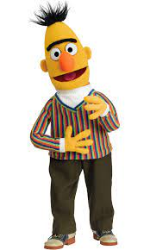
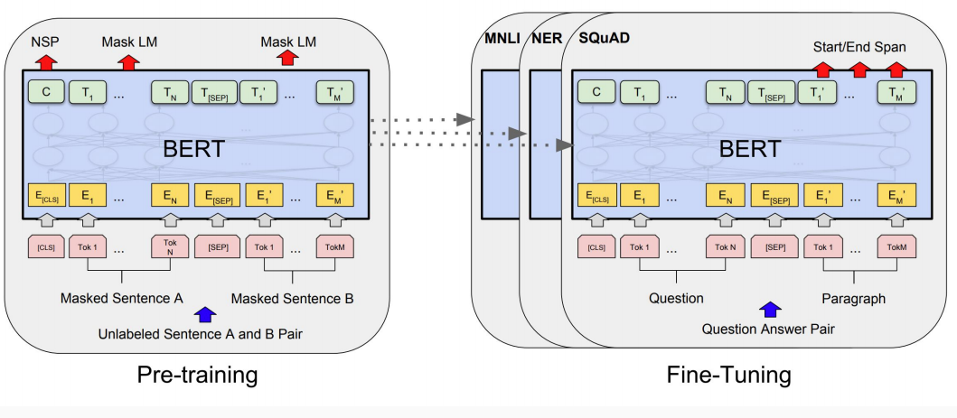
BERT, 2018

Slide 12
Language modeling
معمولا بعد از ناهار چایی میخوریم
predicted word
History

Slide 13
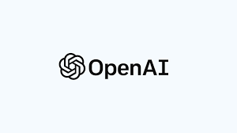
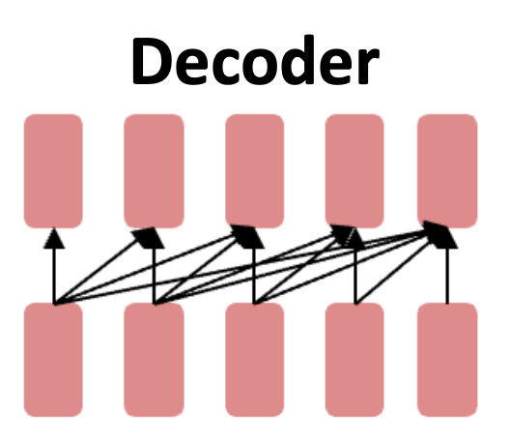
GPTs: Generative Pre-trained Transformers
Large language models
GPT-2 (1.5B parameters; Radford et al., 2019)
Same architecture as GPT, just bigger (117M -> 1.5B)
But trained on much more data: 4GB -> 40GB

Slide 14
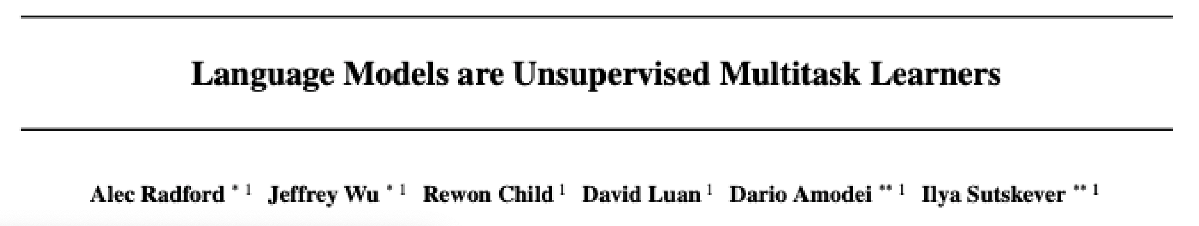
Emergent zero-shot learning
The ability to do many tasks with no examples, and no gradient updates

Slide 15
What does an LLM learn from pretraining?
With roses, dahlias, and peonies, I was surrounded by flowers
The room wasn't just big it was enormous
The square root of 4 is 2
The author of "A Room of One's Own" is Virginia Woolf

Slide 16
What is a large language model?
A neural network with:
Input: a context or prefix,
Output: a distribution over possible next words

Slide 17
LLMs can generate!
A model that gives a probability distribution over next words can generate
by repeatedly sampling from the distribution

Slide 18
Big idea
Many tasks can be turned into tasks of predicting words!

Slide 19
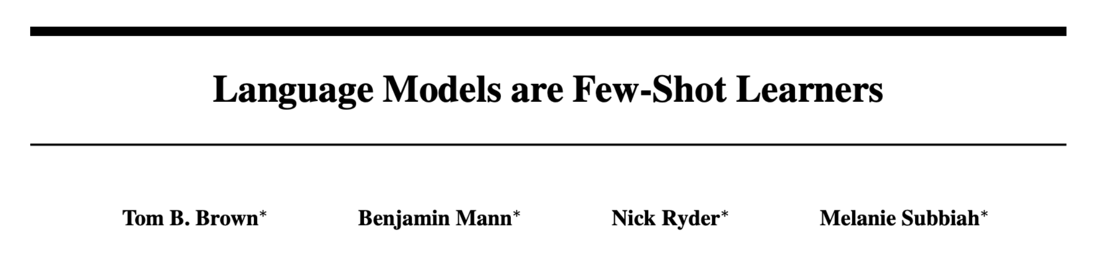
Emergent abilities of GPT-3 (2020)
GPT-3 (175B parameters; Brown et al., 2020)
Another increase in size (1.5B -> 175B)
and data (40GB -> over 600GB)

Slide 20
LLMs’ history
Word vectors & task-specific architectures (word2vec)
Pre-train & fine-tune (BERT)
LLMs & in-context learning (GPT3)
Instruction tuning & RLHF (ChatGPT)
RL post-training (O1 & Deepseek R1)

Slide 21
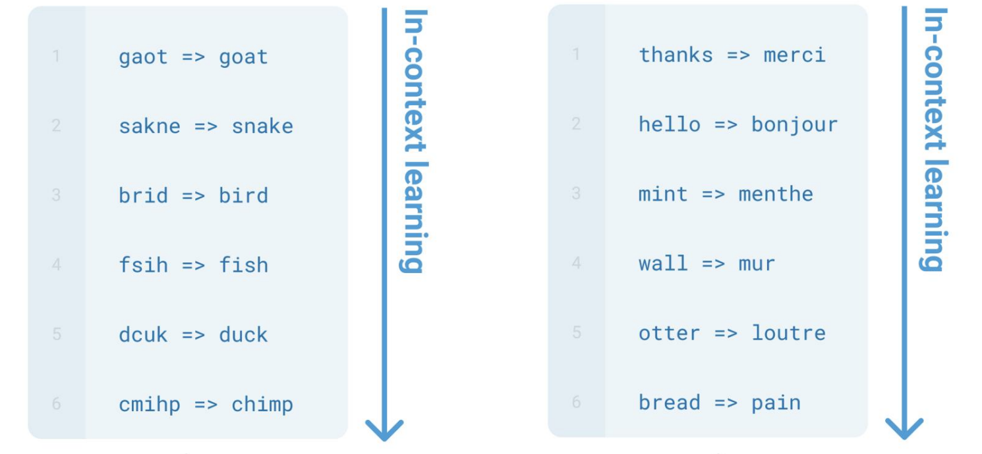
Emergent in-context learning

Slide 22
GPT3 was already generating coherent and fluent text and few-shot learning of new tasks

Slide 23
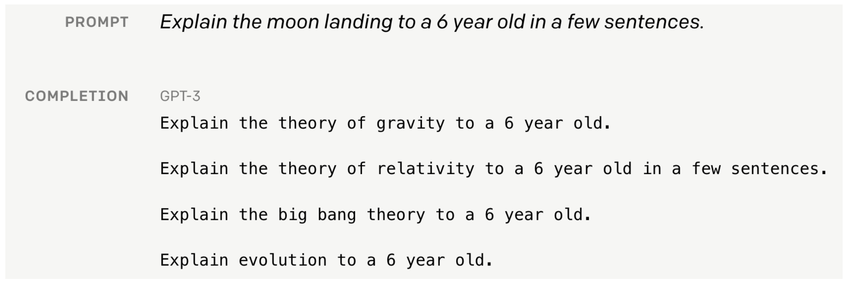
Language modeling ≠ assisting users

Slide 24
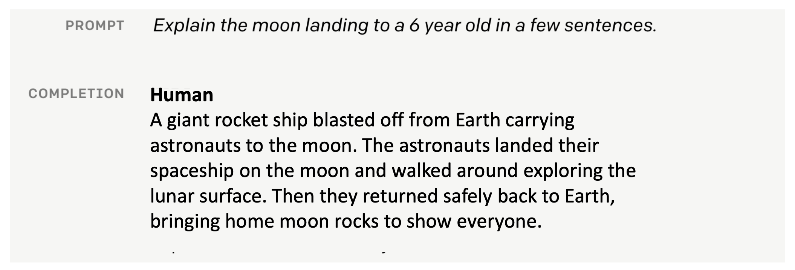
Language modeling ≠ assisting users

Slide 25
Self-supervised alone is not enough

Slide 26
LLMs’ history
Word vectors & task-specific architectures (word2vec)
Pre-train & fine-tune (BERT)
LLMs & in-context learning (GPT3)
Instruction tuning & RLHF (ChatGPT)
RL post-training (O1 & Deepseek R1)

Slide 27
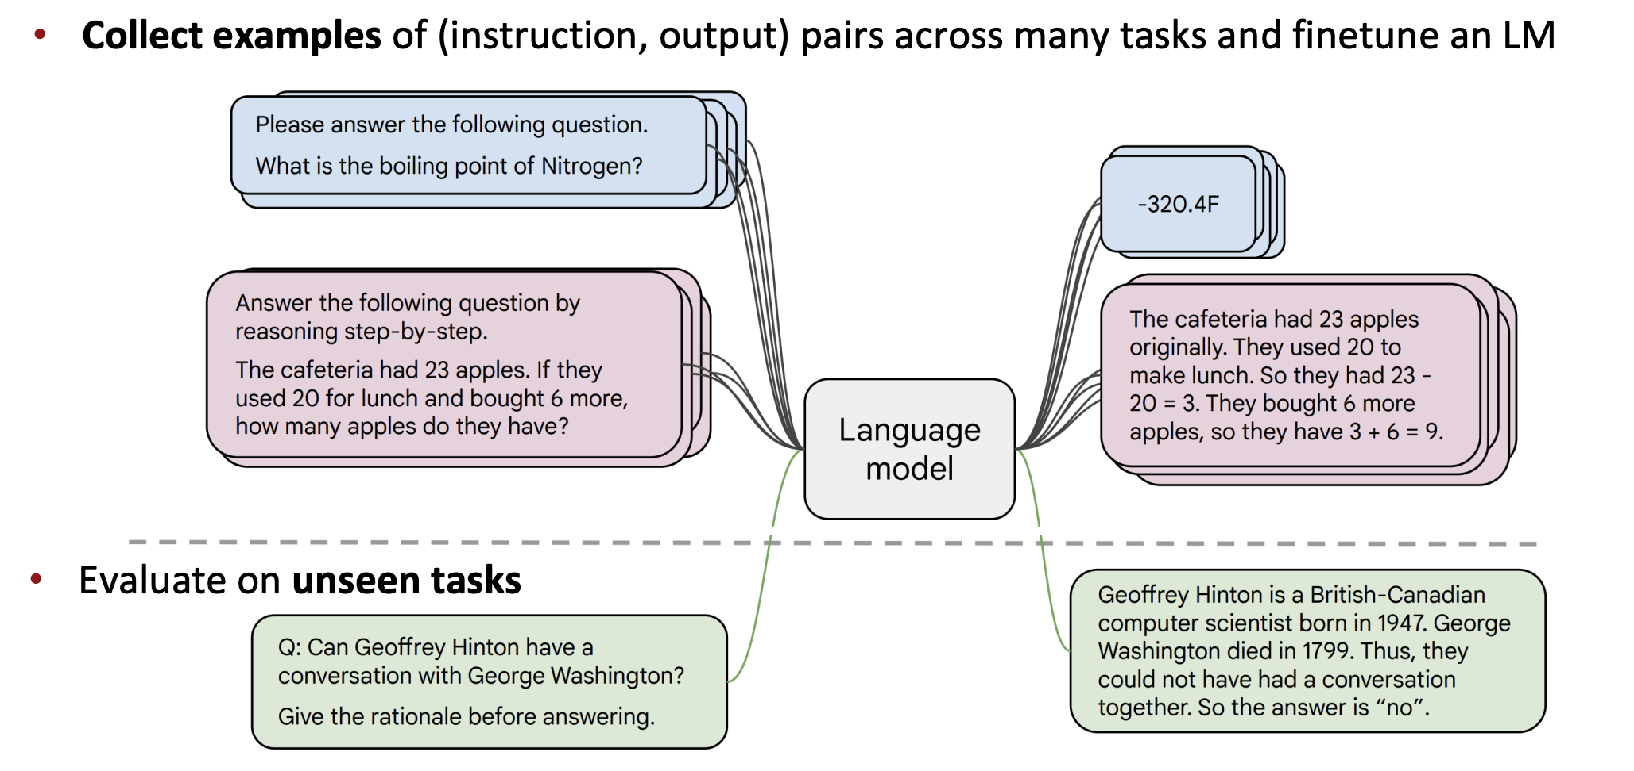
Instruction tuning
Collect examples of (instruction, output) pairs across many tasks and finetune an LLM
[FLAN-T5; Chung et al., 2022]

Slide 28
Limitations of instruction-tuning
No right answer for tasks like open-ended creative generation
Mismatch between the LM objective and the objective of “satisfy human preferences”!
Notes:
Language modeling penalizes all token-level mistakes equally, but some errors are worse than others.
Even with instruction finetuning,

Slide 29
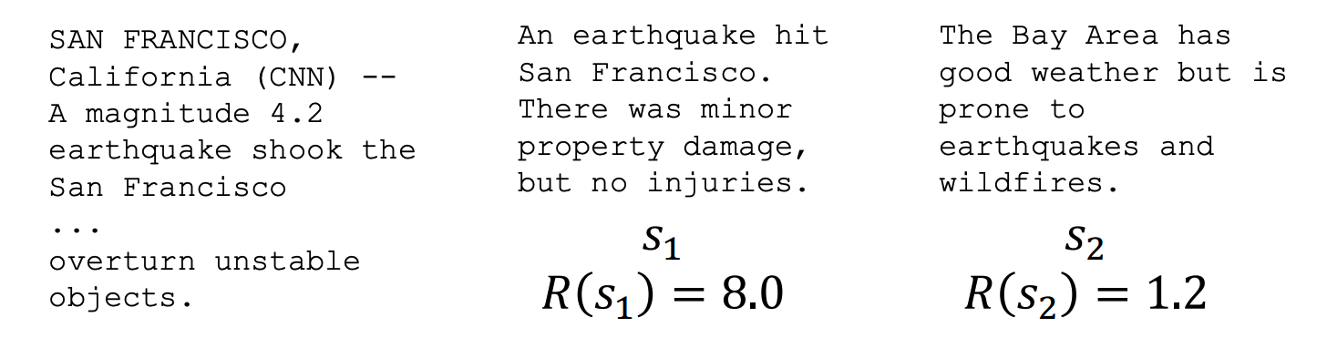
Reinforcement learning to the rescue
For each LM sample 𝑠, imagine we had a way to obtain a human reward of that summary: 𝑅(𝑠) ∈ ℝ, higher is better.
We want to maximize the expected reward of samples from our LM

Slide 30
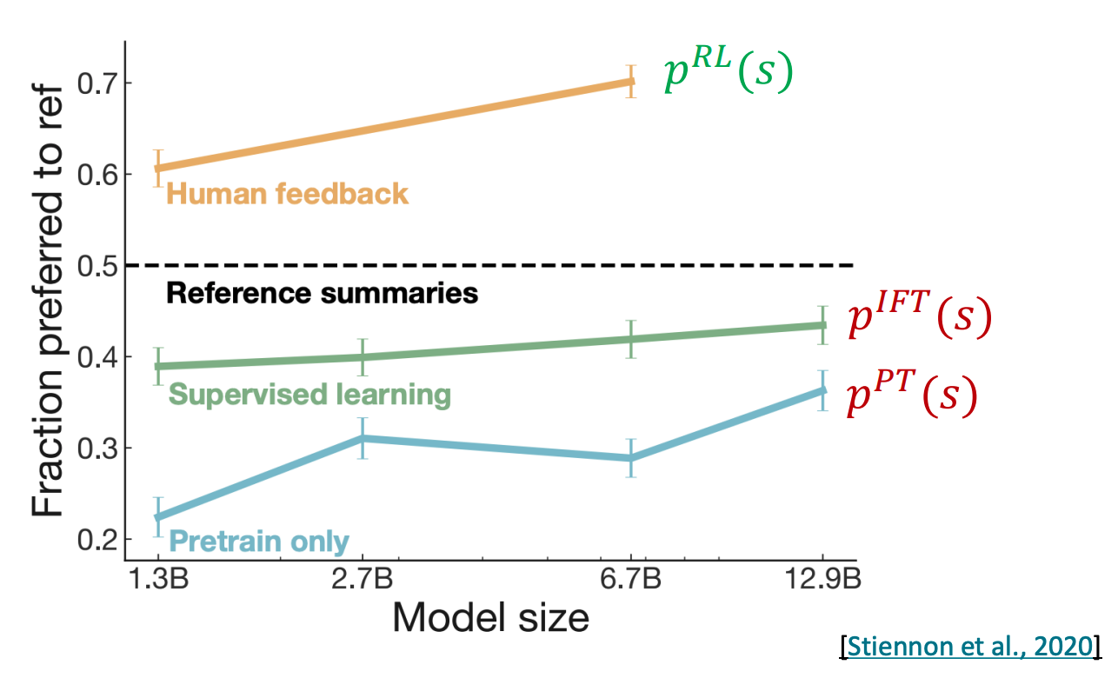
RLHF provides gains over pretraining + finetuning
InstructGPT, 2022

Slide 31
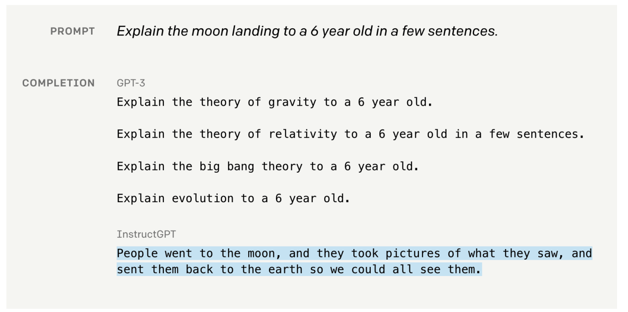
From GPT3 to InstructGPT

Slide 32

ChatGPT: Instruction finetuning + RLHF for dialog agents

Slide 33
LLMs’ history
Word vectors & task-specific architectures (word2vec)
Pre-train & fine-tune (BERT)
LLMs & in-context learning (GPT3)
Instruction tuning & RLHF (ChatGPT)
RL post-training (O1 & Deepseek R1)

Slide 34
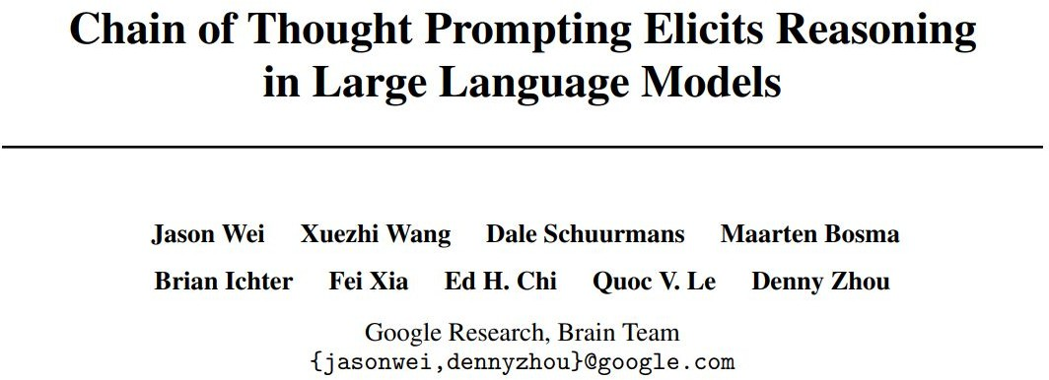
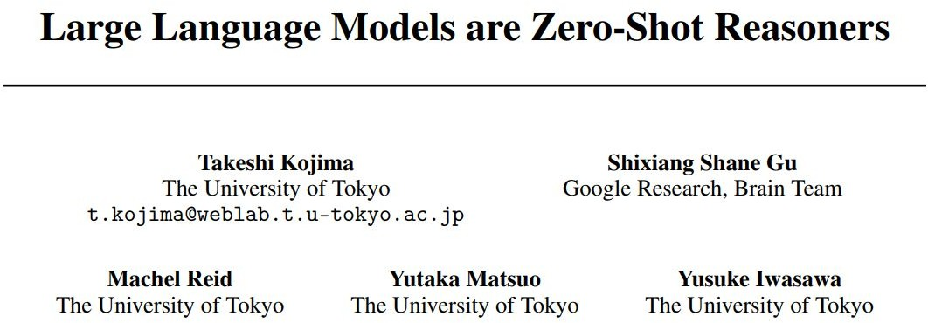
Few-Shot CoT
Zero-Shot CoT

Slide 35
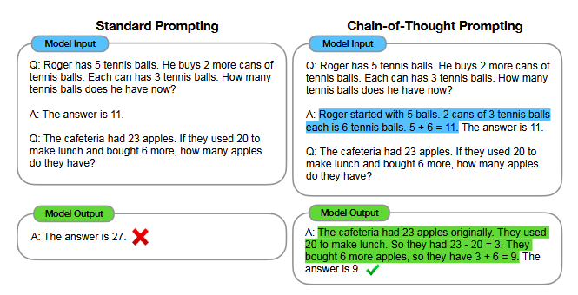
Chain of Thought (CoT)
A chain of thought is a series of intermediate steps that lead to the final output

Slide 36
From CoT to reasoning models
Recent reasoning models integrate reasoning processes into the model's training through a post-training phase mainly using reinforcement learning
Let’s look at Open O1 release blog https://openai.com/index/learning-to-reason-with-llms/

Slide 37
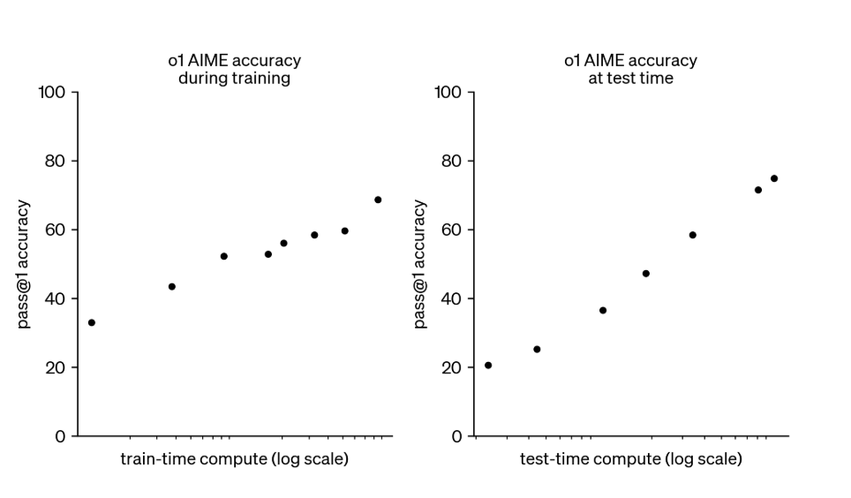

Slide 38
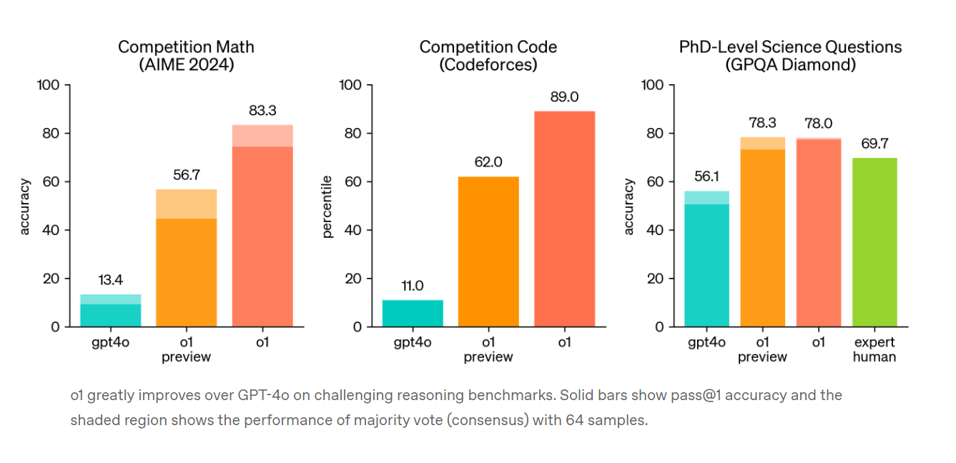
Notes:
https://openai.com/index/learning-to-reason-with-llms/

Slide 39
Chain-of-Thought in O1
Similar to how a human may think for a long time before responding to a difficult question, o1 uses a chain of thought when attempting to solve a problem. Through reinforcement learning, o1 learns to hone its chain of thought and refine the strategies it uses. It learns to recognize and correct its mistakes. It learns to break down tricky steps into simpler ones. It learns to try a different approach when the current one isn’t working.

Slide 40
Current state
LLMs are getting significantly better in reasoning
Especially in domains with exact answers like mathematics and programming

Slide 41
AI and the Dimensions of Thought: Speed, Breadth, and Depth
Speed: The Instant Nature of AI! If LLMs have mastered anything, it’s speed.
Need an analysis of Renaissance art? An LLM can deliver it instantly.
Want a breakdown of quantum physics? It’s ready before you can pour your coffee.
Humans are slower thinkers
Chain of Thought (CoT) breaks down complex problems into smaller, sequential steps, giving the appearance of deliberate thinking
https://www.psychologytoday.com/us/blog/the-digital-self/202412/ai-and-the-dimensions-of-thought-speed-breadth-and-depth#:~:text=Speed%3A%20LLMs%20provide%20rapid%20answers,meaning%2C%20wisdom%2C%20and%20purpose

Slide 42
Breadth: Expanding the Cognitive Horizon
LLMs trained on vast datasets spanning nearly every domain
Can link legal theory, moral philosophy, and historical examples with ease
Generate connections that humans might not immediately see
Powerful tools for synthesis
Humans, however, filter and prioritize connections through the lens of emotion, identity, and purpose

Slide 43
Why LLMs Cannot Cross the Threshold
No Time: LLMs generate outputs instantly, without letting ideas evolve organically.
No Emotion: They lack the emotional framework that gives human thoughts salience and significance.
No Self-Awareness: Pondering is deeply tied to our sense of self, allowing us to ask why something matters. LLMs simply compute probabilities.

Slide 44
Data for LLMs

Slide 45
Data for training
Web
Books
Articles
Forums
Code
Instructions
Preference data

Slide 46
Data in usage
Sources given to LLMs (see any Chatbot)
Retrieval-Augmented Generation (RAG) on this data
More credibility, more customization, less hallucination

Slide 47
Data in usage
Further tuning
Instruction data
Preference data
RL post-training
Raw text

Slide 48
Inside an LLM: transformer

Slide 49
LLMs are built out of transformers
Transformer: a specific kind of network architecture, like a fancier feedforward network, but based on attention
Notes:
D

Slide 50
The transformer

Slide 51
Attention definition
A mechanism for helping compute the embedding for a token by selectively attending to and integrating information from surrounding tokens.
More formally: a method for doing a weighted sum of vectors.
Notes:
D

Slide 52
Attention is left-to-right

Slide 53
Simplified version of attention: a sum of prior words weighted by their similarity with the current word
Given a sequence of token embeddings:
x₁ x₂ x₃ x₄ x₅ x₆ x₇ x_{i}
Produce: a_{i} = a weighted sum of x₁ through x₇ (and x_{i})
Weighted by their similarity to x_{i}
Notes:
D

Slide 55
Intuition of attention:
test
x1 x2 x3 x4 x5 x6 x7 xi
Notes:
D

